Slide 1
A 3.2.1 Database Schemas
Every database relies on a schema, a structure defining data organization and relationships. We'll explore conceptual, logical, and physical schemas, and how they abstractly define data structure at different levels.

Slide 2
Learning Objective
By the end of this chapter, you will be able to:
Define what a database schema is and explain its purpose in database design.
Differentiate between conceptual, logical, and physical schemas.
Describe how schemas define the structure, organisation, and relationships of data.
Explain the role of levels of abstraction in simplifying database design and management.
Illustrate examples of schemas in real-world database systems.

Slide 3
ATL Skill (Thinking): Transfer – connecting real-world examples to abstract database concepts.
TOK -Knowledge and Perspective → Different schemas (conceptual, logical, physical) represent different perspectives of the same knowledge system.

Slide 4
Introduction
A database schema is the blueprint of a database.
It defines how data is structured, organized, and related.
Just like an architect’s plan for a building, a schema guides database design.

Slide 5
Starter activity
Imagine your phone gallery has 10,000 photos.
You need to find a picture from your last birthday quickly.
How would you organize the photos so they are easy to find?
Student Task (Think–Pair–Share – 3 mins):
Think (1 min): Write down 2–3 ways you would organize your photos (e.g., by date, album, tags, folders).
Pair (1 min): Share with a partner – do you organize differently? Why?
Share (1 min): Few volunteers share with the class.

Slide 6
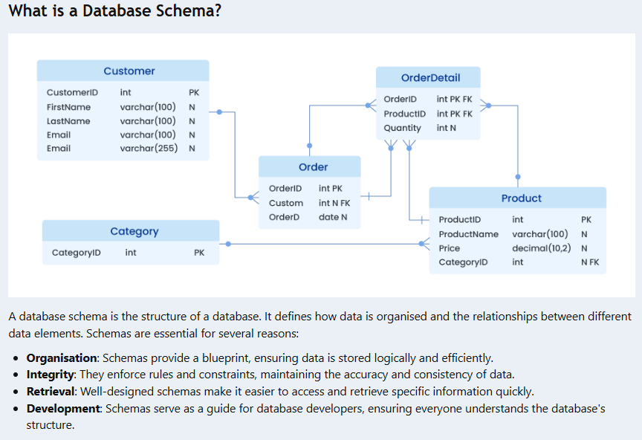

Slide 7
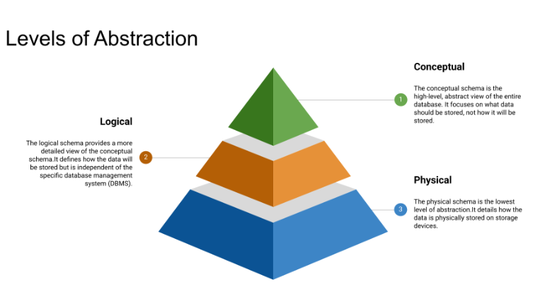
Levels of Abstraction

Slide 8
Conceptual Schema
The conceptual schema is the high-level, abstract view of the entire database.
It focuses on what data should be stored, not how it will be stored.
It identifies the main entities, attributes, and relationships.
It is often represented using Entity-Relationship (ER) diagrams.
Example: For a school database, the conceptual schema might include entities like "Student", "Teacher", "Course", and relationships like "Student enrolls in Course".

Slide 9
Logical Schema
The logical schema provides a more detailed view of the conceptual schema.
It defines how the data will be stored but is independent of the specific database management system (DBMS).
It includes specific data types, constraints, and table structures.
Example: It might define that the “Student ID” is an integer and is the primary key in the student table.

Slide 10
Physical Schema
The physical schema is the lowest level of abstraction.
It details how the data is physically stored on storage devices.
It involves decisions about storage allocation, indexing methods, file organisation, and other hardware/software considerations.
Example: The physical schema might specify that the "Student" table is stored in a particular file system, with a B-tree index on the "StudentID" column for efficient searching.

Slide 11
Abstract Definitions of Data Structure and Organisation
Conceptual Level:
  Entities and relationships are defined in an abstract way.
  Focus is on the overall data requirements and how different data elements relate to each other in a broad sense.
Logical Level:
  Data types (e.g., string, integer, date) are assigned.
  Relationships are defined using primary and foreign keys.
  The organisation is more specific, often using a relational model of tables, columns, and relationships.
Physical Level:
  Data structure involves files, blocks, and storage structures.
  Organization includes indexes, partitions, and physical storage locations.

Slide 12
Importance of Schemas in Database Design
Data Modeling: Schemas are fundamental to data modeling, allowing us to create a blueprint of the database before implementation.
Database Development: They guide the creation of the database, ensuring that the database structure aligns with the requirements.
Data Management: Schemas are critical for efficient data management, including insertion, retrieval, update, and deletion of data.
Communication: They provide a common language for stakeholders (e.g., developers, users, analysts) to discuss and understand the database structure.

Slide 13
Challenge
Describe the purpose of a database schema.
Explain the differences between conceptual, logical, and physical schemas.
Why are database schemas important in the database design process?

Slide 14
IB EXAM STYLE QUESTIONS
Section A – Short-Response (Knowledge & Understanding)
Define the term database schema. [2]
Outline the difference between a conceptual schema and a logical schema. [4]
Identify one advantage of separating database design into different levels of abstraction. [2]
Explain how a physical schema affects database performance. [3]
With reference to an example, distinguish between logical schema and physical schema. [4]

Slide 15
Section B – Extended Response (Application & Analysis)
A school is designing a database to manage students, courses, and teachers.
  (a) Describe the conceptual schema that could be used. [6]
  (b) Explain how this would be represented in a logical schema. [6]
  (c) Discuss the factors that may influence the physical schema design in this case. [6]
Using a real-world example (e.g., online shopping, banking, or social media), analyze how the three levels of schema (conceptual, logical, physical) work together to support database design. [8]
To what extent does the level of abstraction chosen by a database designer affect the accuracy and efficiency of data retrieval? [10]

